Slide 1
Kent Police Payroll
NARPO Reps training day 24/05/2024

Slide 2

Subjects
Introductions – myself, team, XPS
XPS Administration – retirement process
XPS Administration – Pensioner payroll
XPS Portal – Member Self Service
Payroll – Pensioner vs Employee
Tax codes and Personal Allowance
Questions

Slide 3
Introduction - myself
Worked in payroll for 24 years.
I have worked at accountancy firms, pensioner payroll bureaus, group of care homes, security firm, local accountancy firms and a local bureau council (Tunbridge Wells).
I am a tutor for the Chartered Institute of Payroll Professionals. I teach the Foundation Degree in Payroll Management.
I started with Kent Police on 09/01/2023 and am still learning about Police Regs, Force Policies and the Police Pension Scheme.
I won Employee of the Year last week at the Force awards.
Notes:
Introduce myself

Slide 4
Introduction - team
The Payroll and Pensions team process the 6 payrolls a month for Essex and Kent Police, paying 3,700 Pensioners and 13,200 Officers and Staff.
When I joined Kent Police there was a 40% vacancy factor in the team and large backlogs of work due to a historic vacancy factor.
In Sept 23 we filled the last vacancy and were fully staffed!
In April 2024 all backlogs were cleared.
Notes:
Introduce myself

Slide 5
Introduction – Pension Administration
Kent Police was the only Police Force Pension administered by Kent County Council.
At the end of 2022 KCC gave notice to Kent Police that they would not be extending our SLA when it expired on 30/09/2023.
Kent Police started the process to procure a new administrator. XPS tendered and we sought references from numerous other forces before signing contracts with them.
Notes:
Introduce myself

Slide 6
XPS Administration - Retirements
Issues with volume of work for XPS post 01/10/2023 McCloud
Backlog issues
Service Credits from contract invoked
Improvement plan agreed and in place
Lump sum payment timings

Slide 7
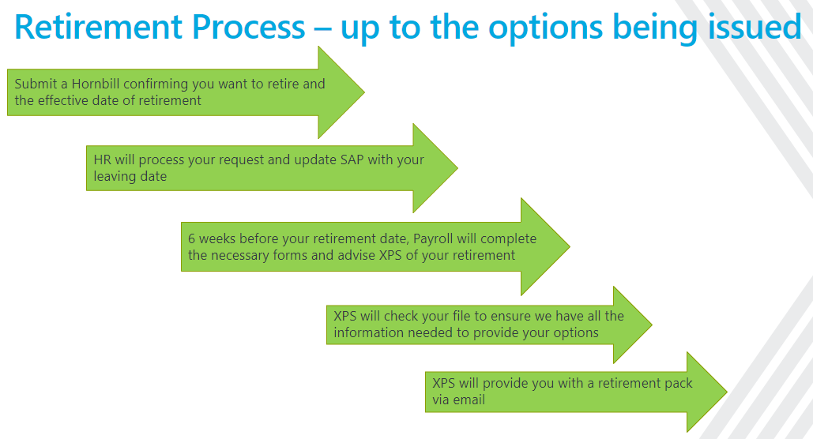

Slide 8
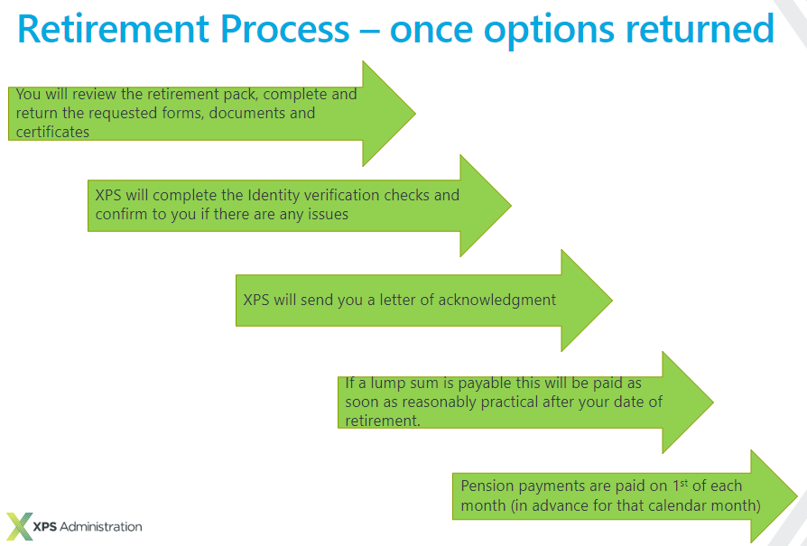

Slide 9
XPS – Member Self Service (MSS) Portal
Payslips and P60’s are available to view and download on portal
Officers who have access to Portal will be able to use the same account to view their pension payslips (they won’t need to re-register).
However, there will be a slight gap in between time they can access MSS from when they go from status 1 (active) to status 5 (pensioner).
In the options pack it states “May we encourage you to register for Member Self Service if you have not already done so at www.myownpension.org.uk. This will allow you to view details of your pension and will hold details of your payslip each month.”
If members need any assistance registering, they can contact the Help Centre as below:
Telephone: 0330 054 5552
E-mail: penmail@xpsgroup.com
Website: www.myownpension.co.uk
Notes:
Introduce myself

Slide 10

XPS Administration – Pensioner Payroll
55.9% of Pensioners have signed up and are using the Member Self Service Portal (the average across other forces is 36.9%
Positive feedback from retired officers
Payroll service

Slide 11
XPS – Pensioner vs Employee
A Pensioner is not deemed an employee under the ERA 1996
Therefore, we are not required to issue a monthly payslip
We used to issue paper payslip, by post, when there was a change in net pay of +/- £5 or more
Pensioners can now view or download their payslip and other documentation every month
Notes:
Any assistance in getting Pensioners to register to use the portal is greatly appreciated
Of course, if someone doesn’t have access, we can agree to send P60’s by paper. We are not doing this if someone is emailing in the request (as they have access to online)

Slide 12
HMRC – Tax codes – application
An individual's personal tax allowance is first allocated against their pension and then against any employment.
The current Standard Personal allowance is £12,570 which is a tax code of 1257L
Other income (rental properties etc), adjustments (tax owed) or historical benefits in kind (company car) can all affect the personal allowance.
Notes:
Introduce myself

Slide 13

Example 1 - Joe Bloggs has a pension of £20,000 per annum and has a part time job that pays £15,000 per annum
Pension - £20,000 gross
£12,570 tax free allowance (tax code 1257L)
= £7,430 subject to tax
20% tax = £1,486
Part time job - £15,000 gross
no tax free allowance (already used for pension)
20% tax on all earnings (tax code BR or 0T)
tax = £3,000
* National Insurance may also be due on the part time job if the member is under state pension age and earns over £12,570 per annum
Notes:
Introduce myself

Slide 14
HMRC – Understanding tax codes
1257L cumulative - £12,570 tax free per annum
1257L month/ week 1 – allocation not cumulative. £1047.50 tax free per month
BR – Basic Rate – all income taxed at 20%
OT – zero tax free allowances
D0 – Higher Rate – all income taxed at 40%
D1 – Additional Rate – all income taxed at 45%
123K – K Code - Tax paid on all income plus code (as per thresholds)
Notes:
Introduce myself

Slide 15
Example - Joe Bloggs has a pension of £20,000 per annum and has a part time job that pays £10,000 per annum
Pension - £20,000 gross
£12,570 tax free allowance (tax code 1257L)
= £7,430 subject to tax
20% tax = £1,486
Part time job - £10,000 gross
no tax free allowance (already used for pension)
20% tax on all earnings (tax code BR or 0T)
tax = £2,000
* National Insurance may also be due on the part time job if the member is under state pension age and earns over £12,570 per annum
Notes:
Introduce myself

Slide 16
HMRC – Tax codes – effect of frozen personal allowance
At March Budget 2021, then Chancellor Sunak announced that the personal allowance (PA) and higher-rate thresholds (HRT) of income tax would be frozen at 2021-22 levels for the four years up to and including 2025-26. At Autumn Statement 2022 Chancellor Hunt extended the freeze by a further two years.
So, what effect has/ will that have on pensioners?
Notes:
Introduce myself

Slide 17
HMRC – Tax codes – effect of frozen personal allowance
April 2023
State Pension - £10,600
Police Pension - £20,000
Total Tax - £3,606 Net take home - £26,994
April 2024 (6.7% increase)
State Pension - £11,310
Police Pension - £21,340
Total Tax - £4,016 Net take home - £28,634
Gross pay increase – 6.7% Net take home increase – 5.7%
Notes:
Introduce myself

Slide 18

Questions?

